Slide 1
Implementing I & E: Intervention & Enrichment
Katelyn Baumgartner

Slide 2
What’s the Difference?
Varied Instruction
Differentiated Instruction
Using many modalities to teach many subjects
Using many modalities to teach ONE concept in a way that targets learners at their personal level of understanding
May use similar strategies for both
Present PowerPoints
Read Alouds
Videos
Manipulatives
Etc.
Both are important to student learning

Slide 3
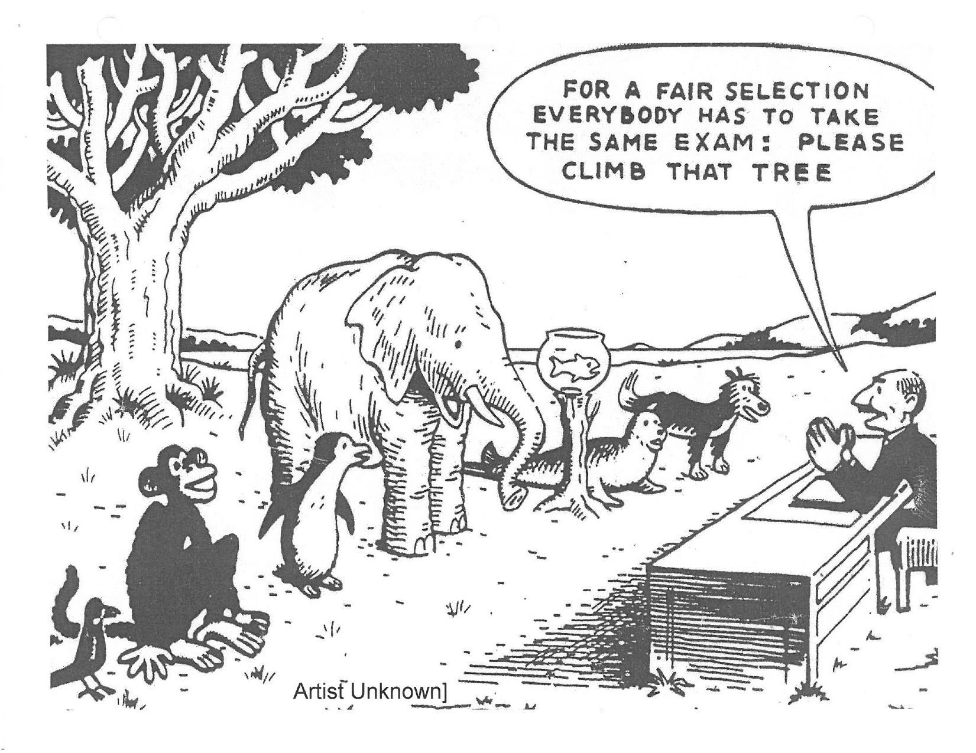

Slide 4
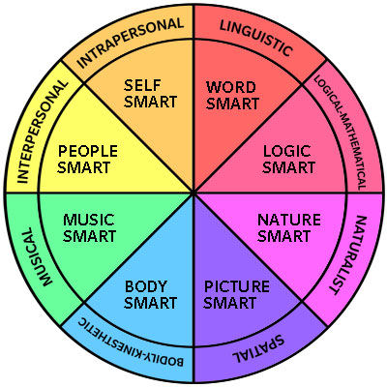
Why Differentiate?
Different Students= Different Experiences / Abilities → Different Needs
Howard Gardner’s Multiple Intelligences (8)
+1= Existential
Multimodal
Year of Growth
Teach UP, don’t dumb DOWN!

Slide 5
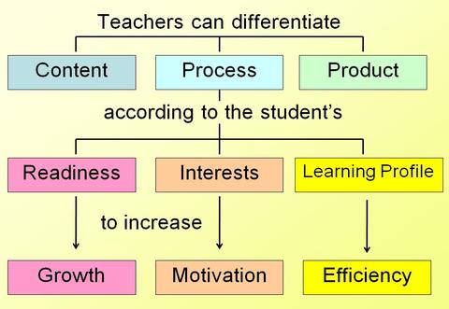
Differentiated Instruction
Mindset
Supportive Learning Environment
Turn and Talk
Appropriate Tasks
High Quality, Aligned Curriculum
Flexible Ability Grouping
Continual Assessment

Slide 6
Differentiated Instruction in Action
Start at 1:00
https://www.youtube.com/watch?v=AqepSNNjowU

Slide 7
How do I differentiate in my School?
I &E Math
Daily 5
Intervention and Enrichment
Communication with other grade-level teachers
Needs-based instruction
Guided reading groups
Flexible ability groups
Choice of activities when not with the teacher
Good Fit Book
Metacognition

Slide 8
I & E Results from Dorothy Moses Elementary
Bismarck is usually above the State average.
Moses is projected to be higher than the District average.
Title 1 School
High Diversity
High Mobility
Low SES
360 Review

Slide 9
I & E in action
Start at 00:30
https://www.youtube.com/watch?v=J8DQugVxHv0

Slide 10
How do I differentiate in my classroom?
Over-plan
Menu options
Project Based Learning (PBL)
For more ideas on how to differentiate instruction visit: http://www.edutopia.org/blog/differentiated-instruction-social-media-tools-john-mccarthy
For more information about how to create curricular menus and choice boards, visit: http://www.teachhub.com/classroom-management-differentiated-instruction-menus

