Slide 1
My Classroom Management Philosophy
By: Katelyn Baumgartner

Slide 2
Environment
Warm/Welcoming
Home away from home
Fun/Engaging
Democratic
Open to discussion/communication
Guidelines/Expectations/Discipline

Slide 3
Discipline
Sparingly
Never Physical
Three-Strike System
Strike 1= intervention w/ student @ beginning of recess
Strike 2= stay in during entire recess/after school
Strike 3= contact parents

Slide 4
Parental Communication
Open lines of communication
Monthly Newsletter
Upcoming events
Standards to be covered
Homework checks need to be signed

Slide 5
Classroom
Layout

Slide 6
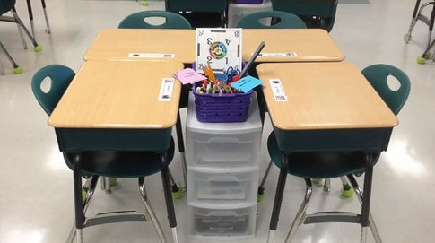
Seating Arrangement
Pods
Seats Labeled
3-4 students/pod
Adapt to student behavior

Slide 7
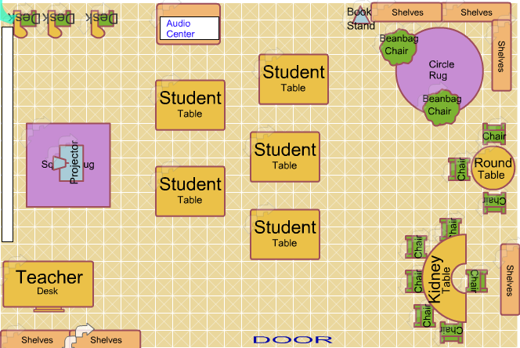
Stations
Classroom Library
Writing Station
Work tables

Slide 8
Procedures

Slide 9
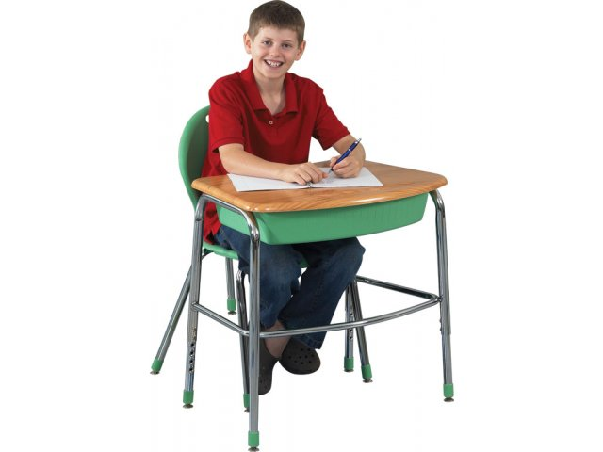
How to Sit in a Desk
Face desk
Feet on the floor
Bumper in the seat
“Four on the floor”

Slide 10
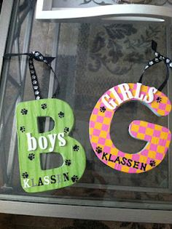
Bathrooms
Markers
Start on teacher’s desk
Need to be placed on student’s desk
1 boy/1 girl
Emergency Clause

Slide 11
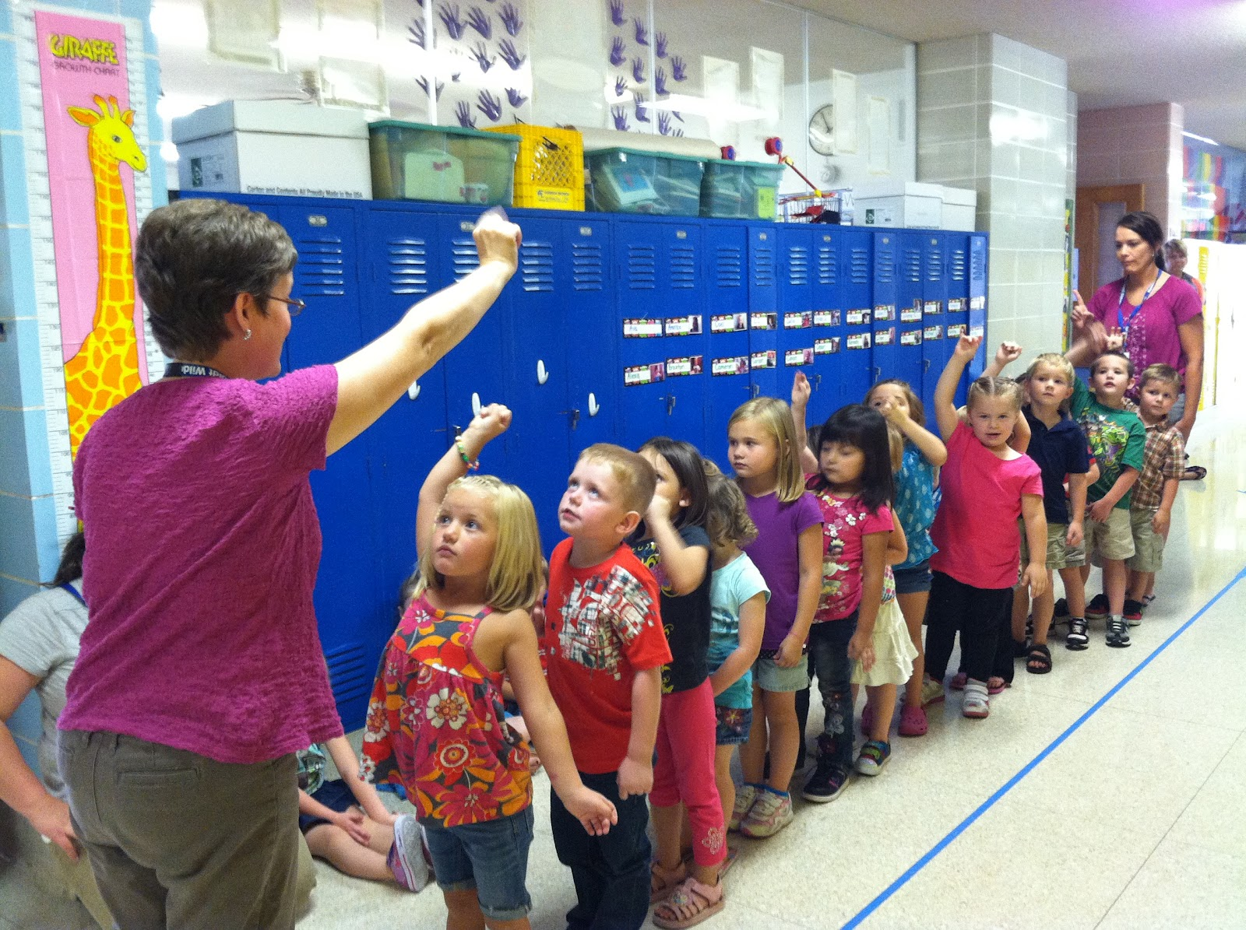
How to Walk in the Halls
Exit song
Single file
Hands @ sides
Voices off
Walking feet
No running/no lagging

Slide 12
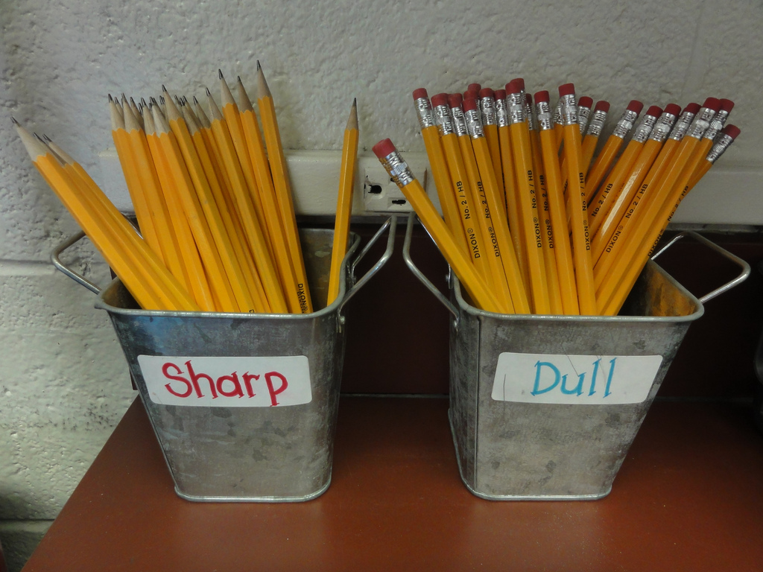
Pencil Sharpening
All bring packs
2 at desk
Two jars
Sharp pencils
Dull pencils
Teacher or student in at recess sharpen all dull

Slide 13
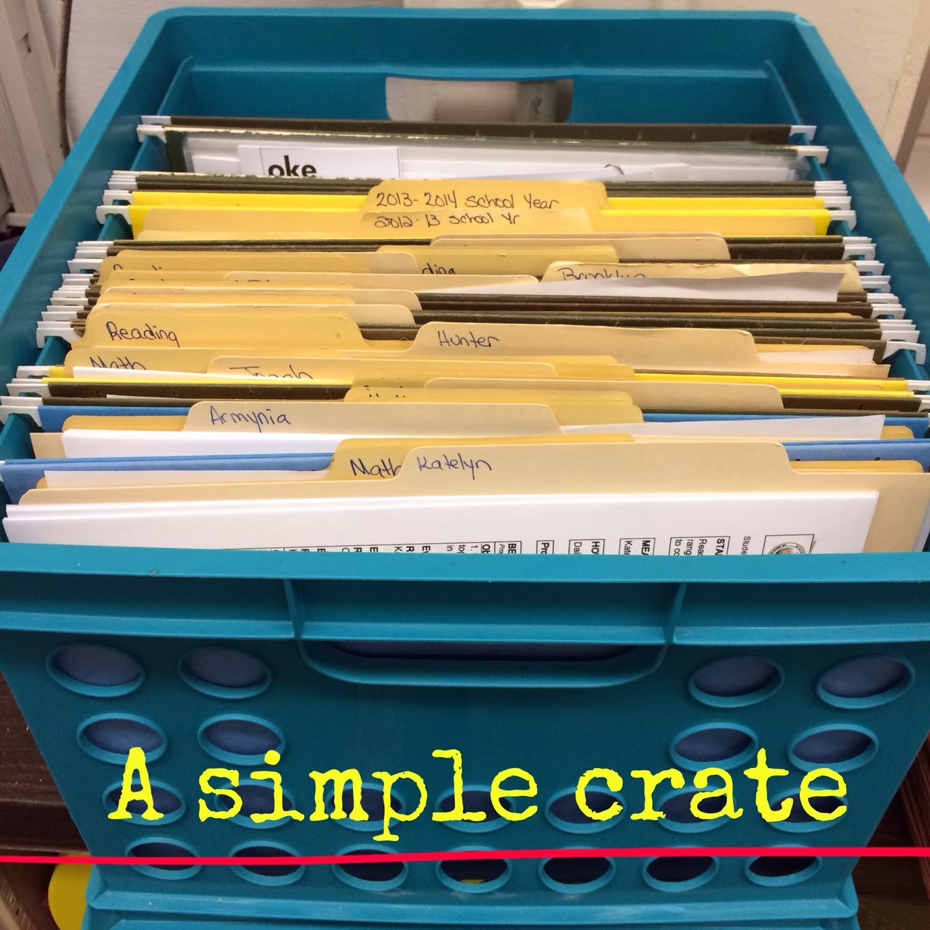
Work in Progress Folders
Box with folder for each student
Unfinished work → folders
Finish early→ return to folder
Check all folders before afternoon recess
3+= stay in to work
Check @ end of day→ leftovers go home
Given 2 days to finish/return

Slide 14
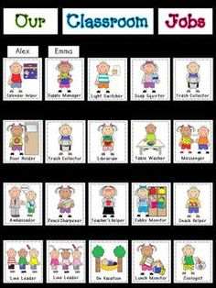
Job Chart
Rotate weekly
Visible at all times
Random drawing @ beginning of each month
Students choose job
Clean-up crew (2), lights monitor, library helpers (2),
line leader, pledge leader, paper passer

Slide 15
Behavior Management System
Chips for Choice
Earn chips for good behavior
Being only student to do their job, helping other students, random acts of kindness
Lose chips for misbehavior
Distracting behavior, running, misusing materials, disrespect, late homework (2 +days)
Reward at the end of the week for certain # of chips

Slide 16
Daily 5
Scaffold introduction of options
Slowly extend duration
Post rotations on chart
Students can choose their own order

